Slide 1
The Theatre Royal Booking Application
Technical Presentation

Slide 2
Devising a plan
Decide how the team would
Communicate – Slack
Manage version control – GitHub
Manage how we would work alongside each other and distribute tasks
Trello
Organise and share schedules
Team meeting every night to discuss progress, focus of the next day
Upon receiving the design specification and Moscow requirements
Break down the requirements and milestones into concise objectives
Order objectives into logical steps
Set a design philosophy
Design the program to be flexible and adaptable to allow for future updates and expansion

Slide 3
Where to start?
Identify concerns within the program
Things we don’t know
Things that might be an issue
Design the ERD
Figure out what data we would want to store based on the specifications
Go through the ‘normalisation’ process to make the data efficient with as little duplication as possible
Revisit this as we progress
Design the conversation between the program and the user
How the conversation would develop
Design the class diagram
Figure out the main ‘model’ of the Theatre
Aka ’physical entities’ of the theatre (show, performances, tickets, a checkout/basket)
The front-end controller and back-end controller
The Database Connection class
Utility classes needed
Classes that will control how we get data such as date/time, how we format certain Strings

Slide 4
SQL Concerns
Have SQL data stored in the program? Or have data always streamed from the database to allow for the most updated data?
Constantly updated data is better to allow for clearer and updated information to be passed to the user
How to get around the issue of multiple users adding tickets to basket?
Ideally have a system that changes the database accordingly when a User puts their tickets in their basket
Though ideal, requires a complex system. Keep it simple for now, add complexity later
For now, only insert data into the database when a User has confirmed the payment
This does present the problem when multiple users are selecting the same last tickets for their basket
Will need updating at a later stage, especially if the application extends to a web program

Slide 5
Application / Java concerns
How to get time/date data in Java?
Timestamp/Data/SimpleDateFormat/LocalDate
How to validate a Credit Card?
Luhn algorithm
How to organise the class system within the program to allow references of complex SQL data queries?
Establish relationship between DB Connector and BackEnd Controller

Slide 6
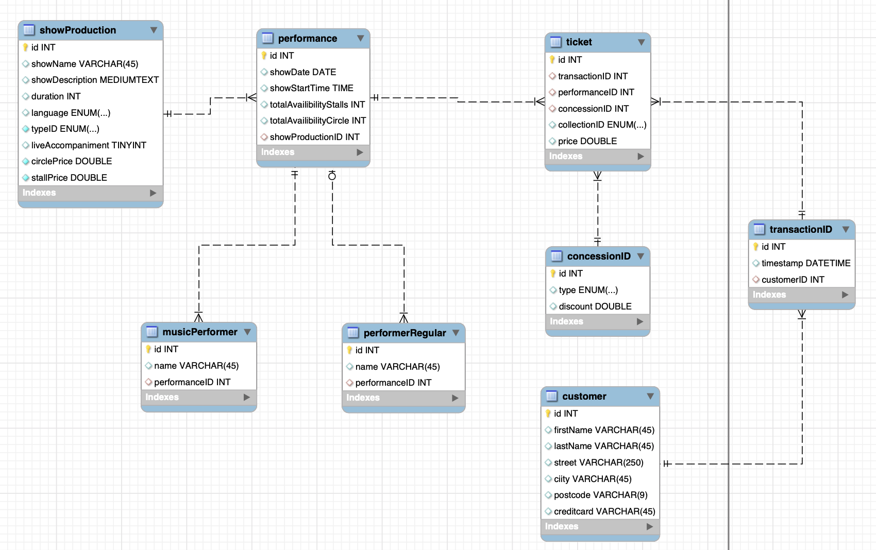
ERD

Slide 7
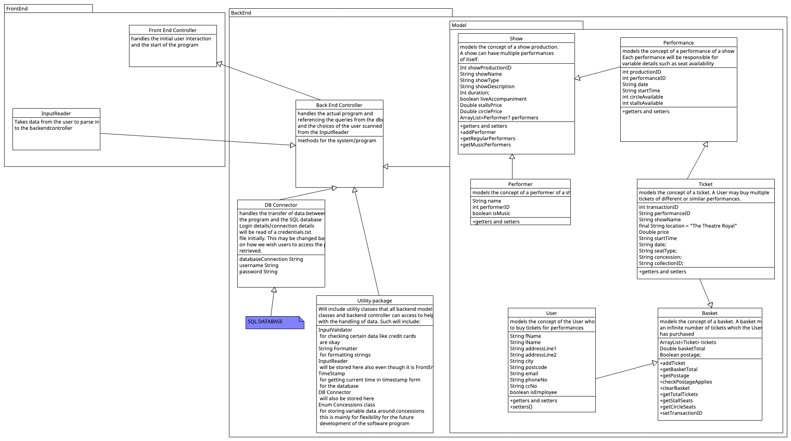
Class Diagram

Slide 8
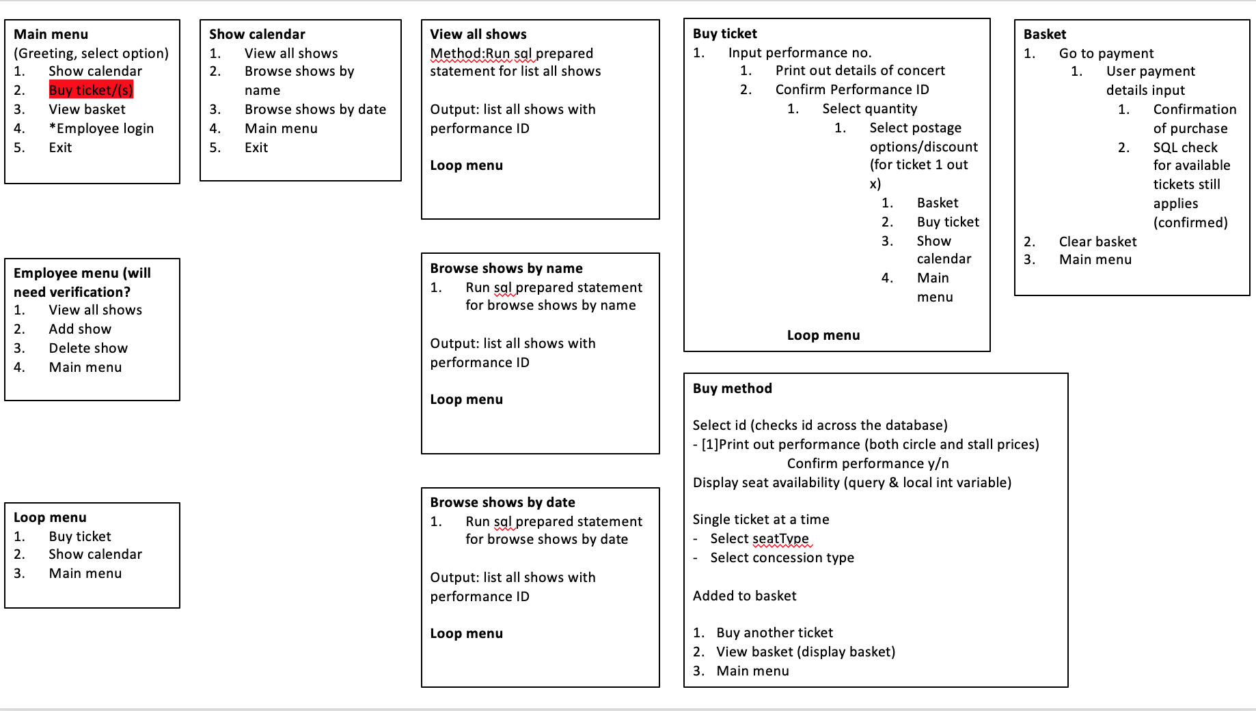
Controller Branch (Conversation with the User)

Slide 9
Meeting with Client
Establishing facts and certain information required
Getting questions about things we’re not sure about
What data they want to see in the report?
What data may we ask of the customer/user?
Spoof data for us to base the model on?
Revisit the designs > update designs > ready to program

Slide 10
Design Cycle
Create tests to figure out code
Write the code in the system
Run tests
Team revisit/meeting to move on to the next stage
Identify MoSCoW requirement

Slide 11
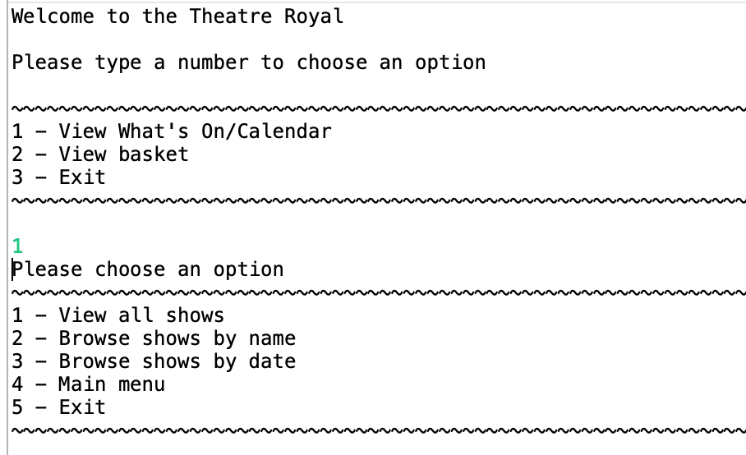
Final Program - Welcome

Slide 12
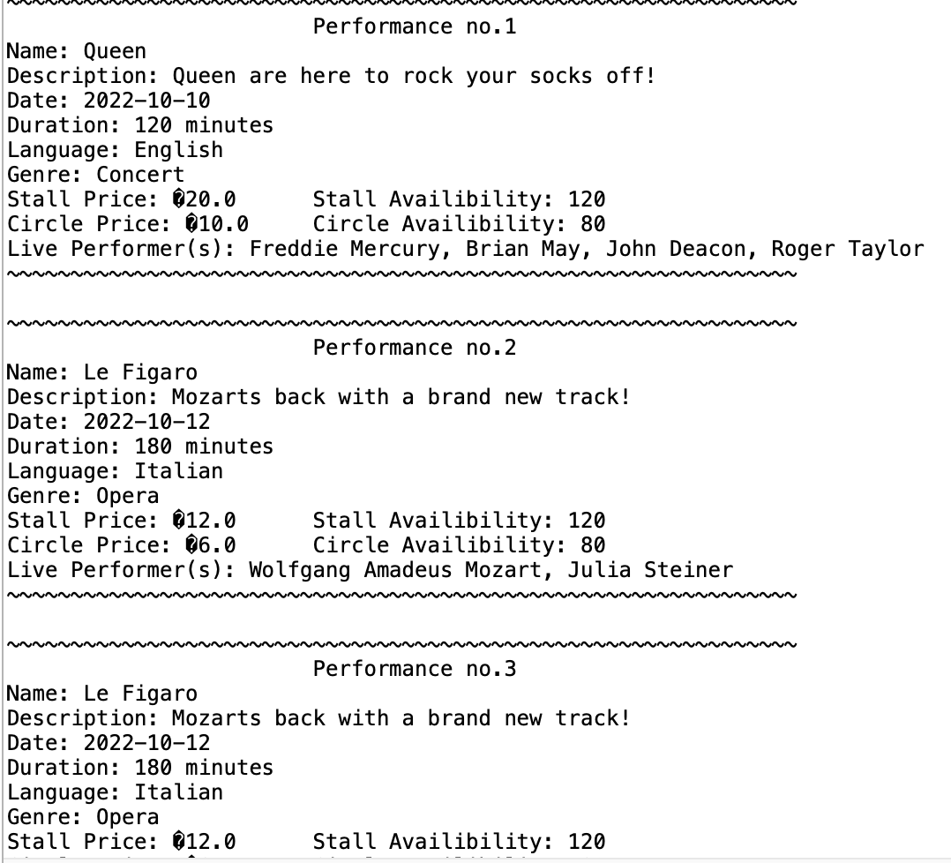
Final Program – List All Shows

Slide 13
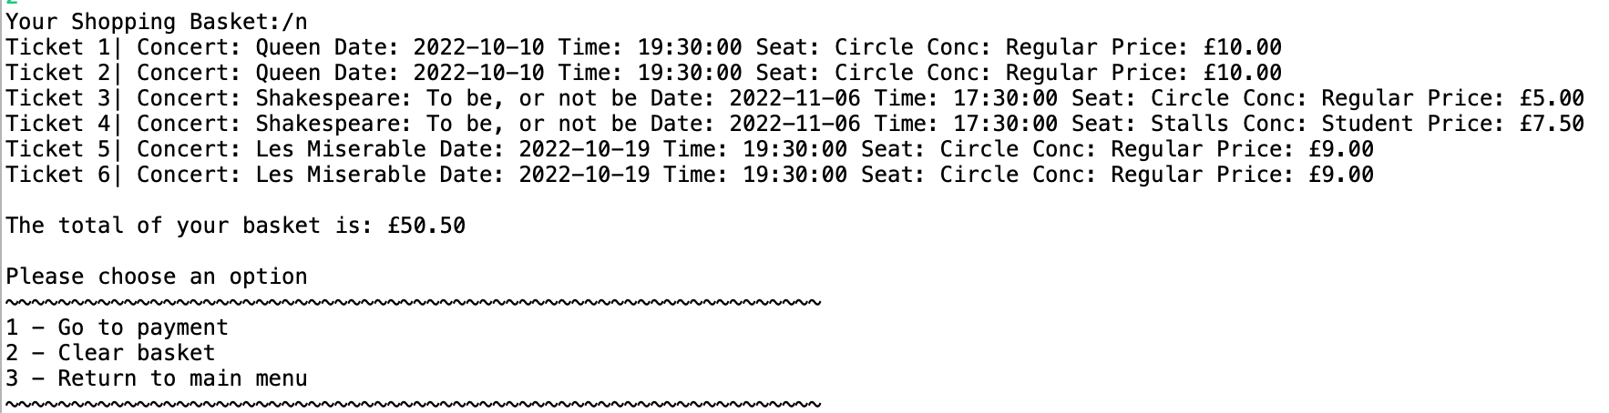
Final Program – View Basket

Slide 14
Known Bugs/Problems
Some search results return an error message stopping the program
SQL Query to retrieve music performers stops when there are no music performers for a show. Currently the work around is to set a music performer for a performance with all fields amounting to null
Some strings present ’odd’ symbols/characters.
Believe this to be a mac/windows translation problem
Shows which have already started will still be listed in the database
The SQL queries need to be updated to reflect this in the program
For now the database must be updated each time any concert has already started

Slide 15
Urgent updates needed
Update the search function account for all possible user inputs
Updating the SQL queries to account for bugs
Fix the ‘odd’ character/symbols bugs

Slide 16
Nice to have additions
Clean up the code
Some classes (especially the backend controller) have become convoluted with code. A few days to redesign the UML and separate methods would do a lot for future adaptation of the application
Could requirements from MoSCoW
Admin users can add performances (this relates to the model classes Show and Performance)
Tickets printed to a file system
Refresh function to enable data to be constantly updated without user input or confirmation of purchase
A GUI to make the User experience nicer

Slide 17
Challenges
Realising how to update to the program as we went along
How to join SQL statements on certain conditions (if show has liveAccompaniment for instance)
Where to use the ‘model’ classes
Show/Performance class only needed for admin user side (adding shows/performance
Working in a team with different schedules
1 Team Member could only work evenings
1 Team Member had to pull out of the project due to unforeseen circumstances
Different team members needing to work on the same classes at the same time

Slide 18
Reflection
In fairness, this was all our first time creating an application of this scope
The level of complexity was unknown
The amount of code of required was unknown
We adapted well as a team to the new challenges, especially thanks to everyone's commitment to the project
What could have been done better:
More rigorous tests to account for varying potential bugs
A more thorough class diagram to separate responsibilities in the program
A better timeline of when we needed to achieve the milestones
Later part of the development cycle was rushed and this impacted the clean format of our code

Slide 19
Any Questions?

